Slide 1
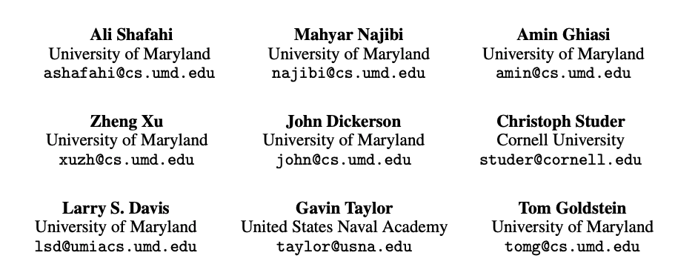
Adversarial Training for Free!
Presenter: Peng, Dan (Harbin Institute of Technology, Shenzhen)

Slide 2
Outline
Preliminaries & Motivation
Approach
Results
Discussion
Conclusions

Slide 3
Preliminaries & Motivation
Adversarial examples
PGD-based attack
PGD-based Adversarial training

Slide 4
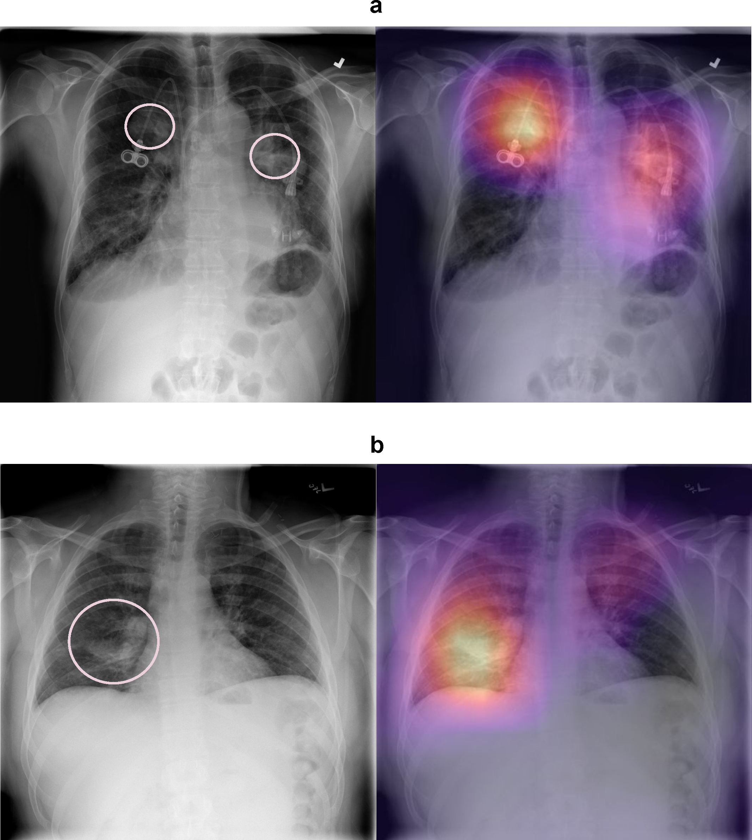
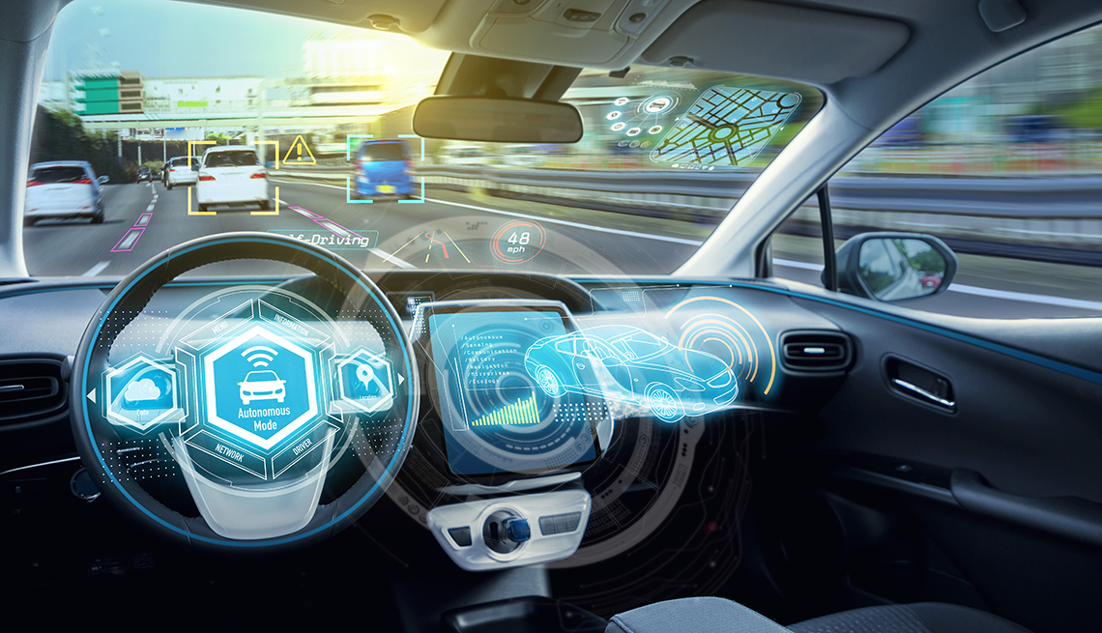
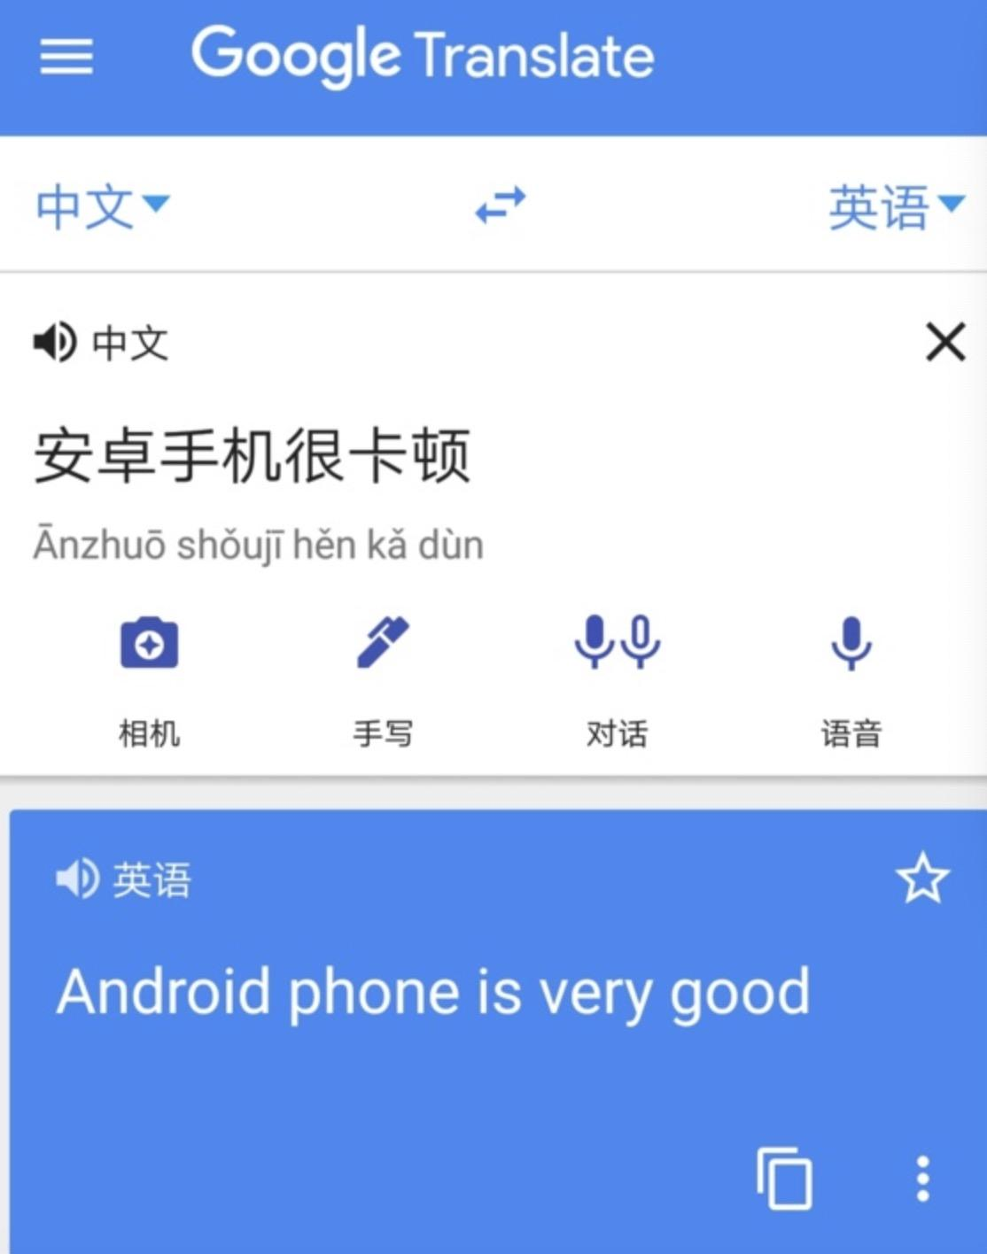
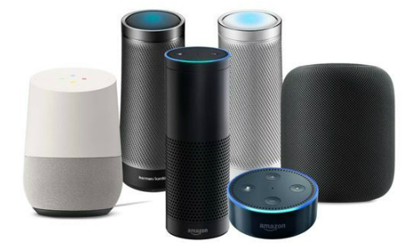
DNN’s phenomenal success
Self-driving Vehicle
AI Health
Smart Speaker
Translation
Notes:
I guess all of you agree the fact the deep neural network have achieved phenomenal success in many tasks.

Slide 5
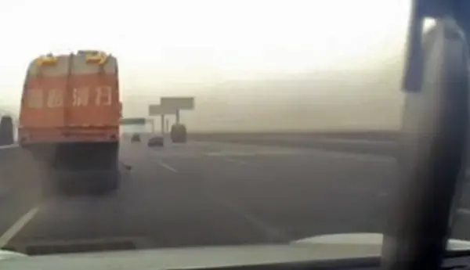
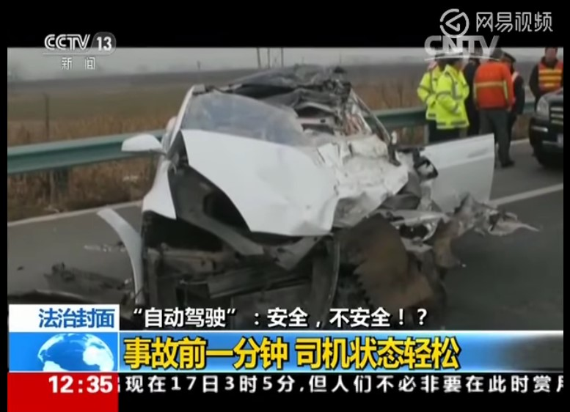
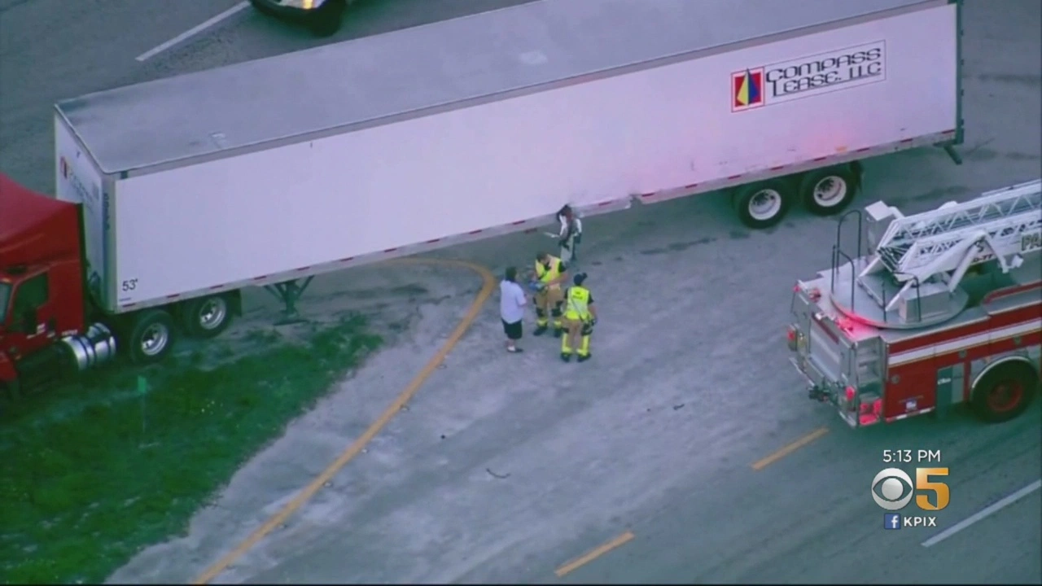
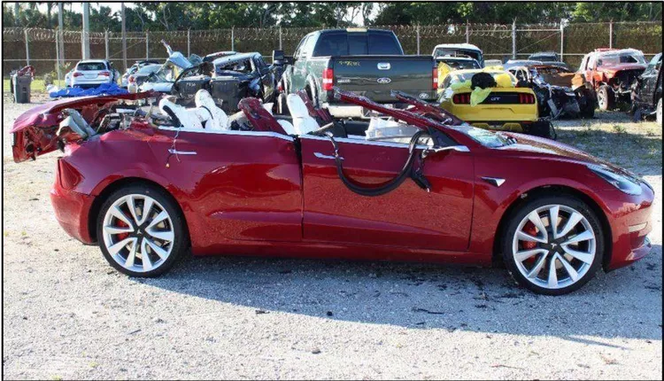
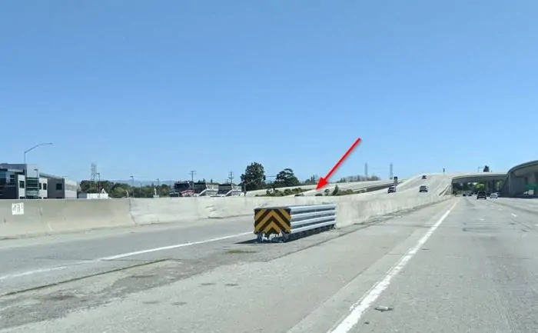
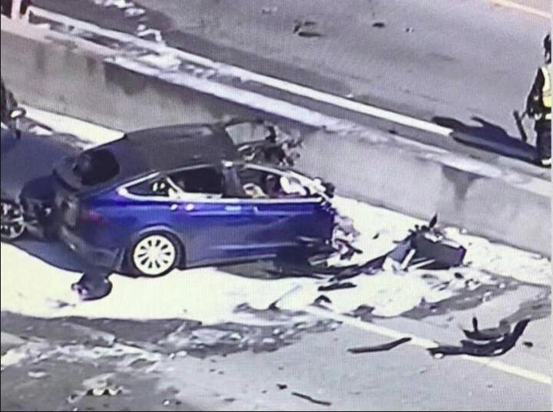
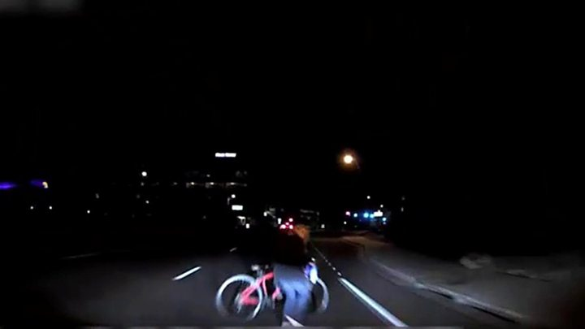
DNN is vulnerable
Stationary sprinkler
=> Ignorable noise
White high truck => Beautiful cloud
Lane divider => Wider road
Fatal crashes
Bicyclist => Plastic bag
Notes:
Unfortunately, Deep networks frequently make mistakes
Slide shows pictures from a Tesla fatal crash.
See the picture: autopilot failed to recognize a white trailer against the bright sky

Slide 6
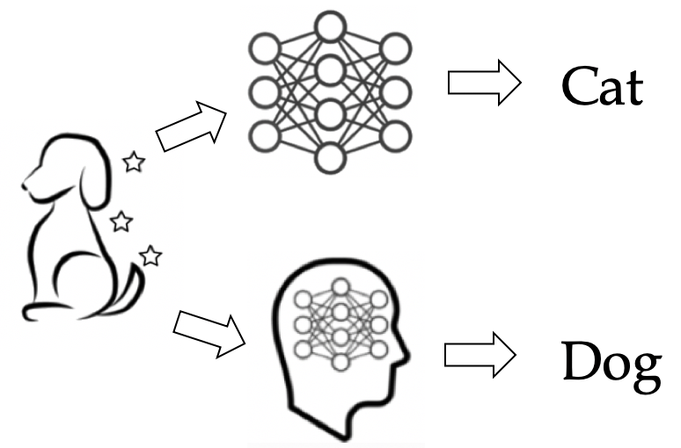
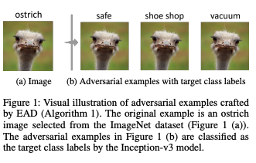
Adversarial examples?
Any valid inputs to machine learning models
Intentionally designed to cause mistakes^{[1]}
[1] Gamaleldin F. Elsayed, Shreya Shankar and Brian Cheung et al. 2018. Adversarial Examples that Fool both Human and Computer Vision.
Notes:
In general, adversarial examples are any valid inputs to machine learning models including deep networks, which intentionally designed to cause mistakes.
As shown in the picture, this is a dog for human, but it will be recognized as a cat by the deep network.
How to generate adversarial examples?

Slide 7
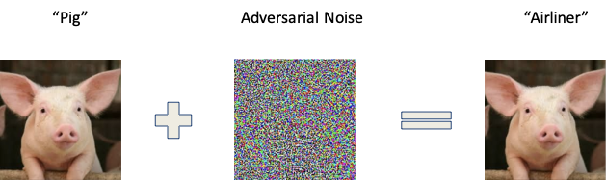
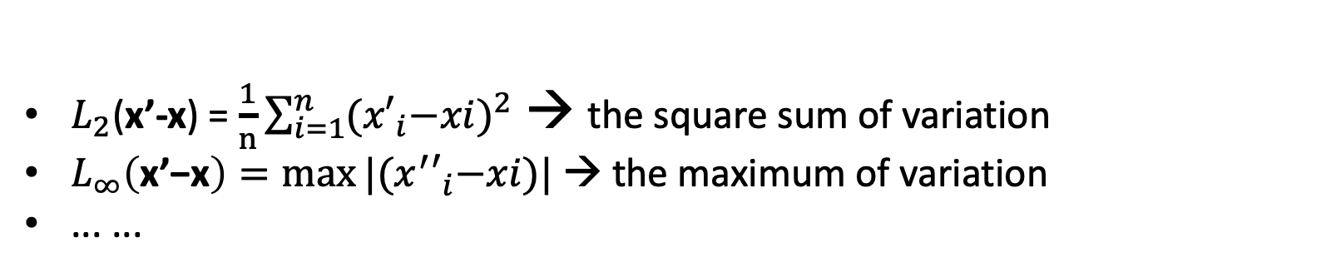
Perturbation-based Adversarial example
x’: adversarial image
f： target model
difference between generated sample and original input
ground truth
cause misclassification
keep valid from human eye
$L_{2}$(x’-x) = $\frac{1}{n}\sum_{i=1}^{n}{{{(x′}_{i}−xi)}^{2}}$ → the square sum of variation
$L_{∞}\left(\text{x}\text{’−}\text{x}\right)=\max{|{(x^{′}′}_{i}−xi})|$ → the maximum of variation
... ...
Notes:
Here, we focus on perturbation-based adversarial examples. say we generate adversarial images by adding well-designed small perturbation on natural image
because the small perturbation wont hurt image, so we can ensure the generated sample still natural, realistic for human eyes
In the context, attackers aim to generate adversarial examples, which will mislead the target model, and ensure the perturbation is human-imperceptible.
Usually, we define the size of perturbation using L2 or L inf norm metric. For L2 norm metric, it compute the square sum of all pixels of the perturbation. while L inf metric define the maximum of all pixels in the perturbation.

Slide 8
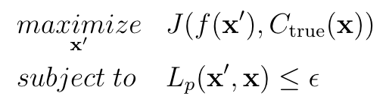
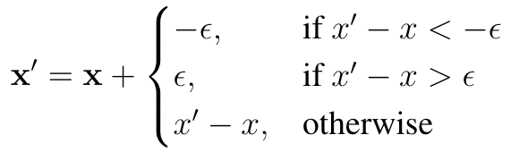
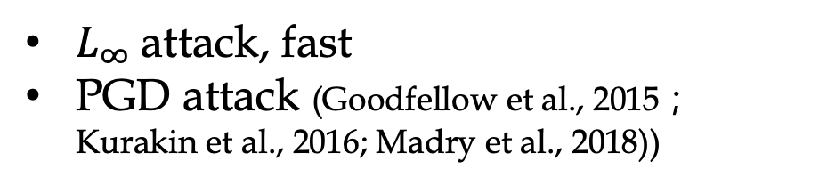
Generate adversarial examples
1. Maximize the loss function while 2.minimizing the norm of perturbation
min the norm under constraint on the loss
max the loss (constraint on the norm)
J: distance function
L₂ attack
C&W attack (Carlini & Wagner, 2017)
search hype-parameter c → slow
$L_{∞}$ attack, fast
PGD attack (Goodfellow et al., 2015；Kurakin et al., 2016; Madry et al., 2018))
Notes:
So, let’s see how to generate adversarial examples
Our aim is to ensure the prediction of the target model is different from ground truth, at the same time, we need perturbation is small.
So, To formulate the aim into an optimization form, we should maximize the loss function of prediction and ground truth, also, minimize the norm of perturbation.
We can rewrite the goal into two types of optimization formula.
First, we can combine this two things into an unconstrained optimization problem
Also, we can constraint the norm of perturbation by a small threshold, then maximize the distance between prediction and ground truth.
However, solve the unconstrained optimization need to search the suitable hype-parameter c, so the process is slow. Usually, we consider L2 norm for this, and the strongest L2 attack is C&W.
For the constrained optimization, it’s easy to implement the constriant for L inf norm , we confine each pixel to a given range. we just need to clip the perturbation when they go beyond the given range.
However, it is hard to project the perturbation to a constrained L2 norm range.
So we usually formulate the constraint optimization with L inf norm metric . the most effective of this kind L inf attack is PGD.
Note, L inf attack is much faster than L2 attack, because it is unnecessary to search the hype parameter c

Slide 9
Preliminaries
Adversarial examples
PGD-based attack
PGD-based Adversarial training

Slide 10
How to defense PGD-based adversarial examples
PGD-based Adversarial training_{(Madry et al., 2018)}
Generate PGD adversarial examples,
training with PGD adversarial examples
Computationally expensive!
GPUs ; times; Power
CIFAR-10 and CIFAR-100, multiple days.
ImageNet: _{Xie et al. [2019]} use 128 V100s ; _{Kannan et al. [2018]} use 53 P100s
adversarial
examples
Train

Slide 11
Outline
Preliminaries & Motivation
Approach
Results
Discussion
Conclusions

Slide 12
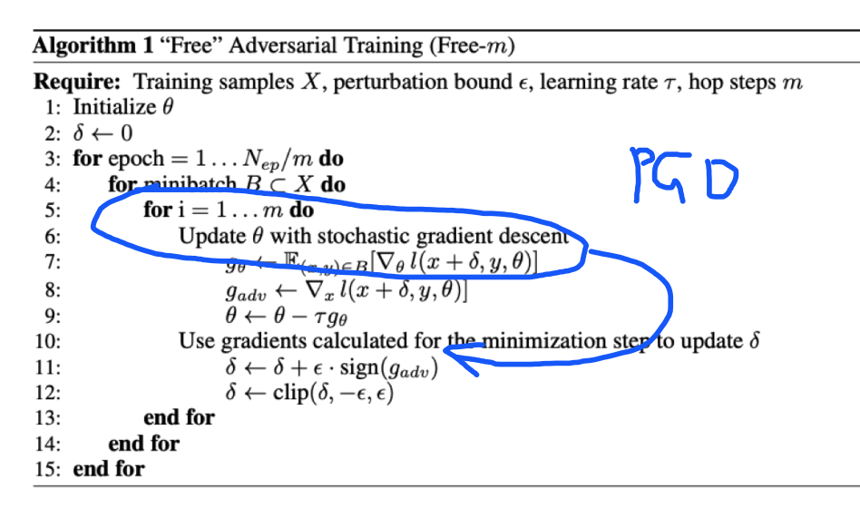
How to speedup adversarial training
Only estimate gradient once!

Slide 13
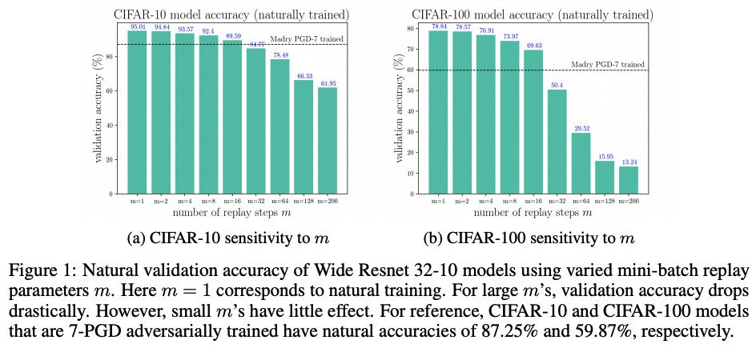
mini-batch replay m
Why need replay?
PGD attack : multiple updates ...
The effect of mini-batch replay on natural training

Slide 14
Outline
Preliminaries & Motivation
Approach
Results
Discussion
Conclusions

Slide 15
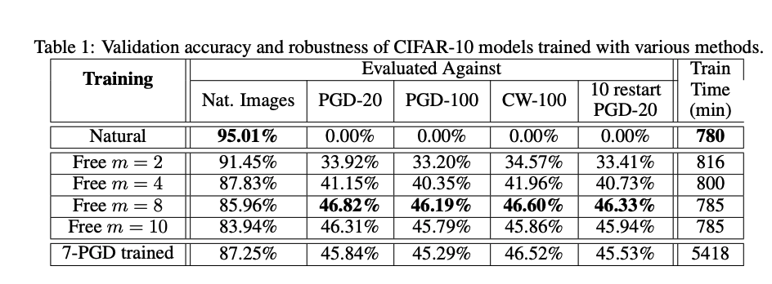
Results on CIFAR10/100(1)

Slide 16
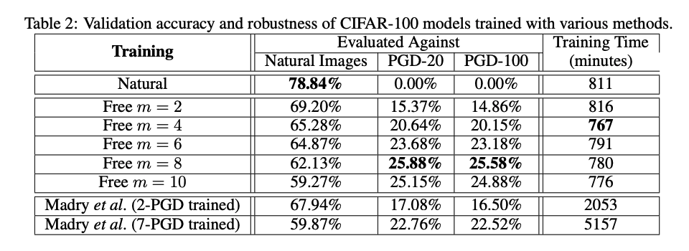
Results on CIFAR10/100(2)

Slide 17
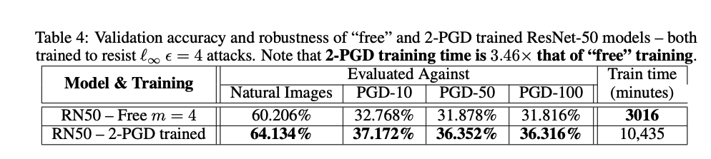
Results on ImageNet(1)
3.4 X fast

Slide 18
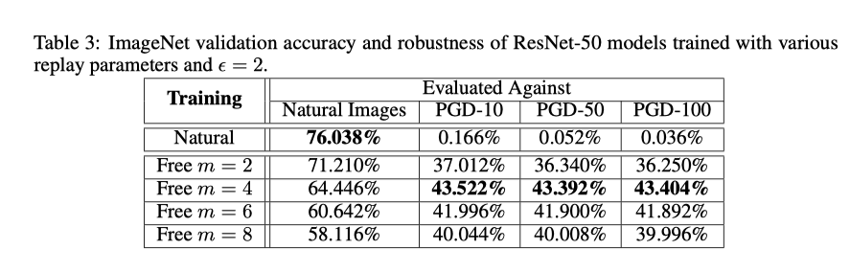
Results on ImageNet(2)

Slide 19
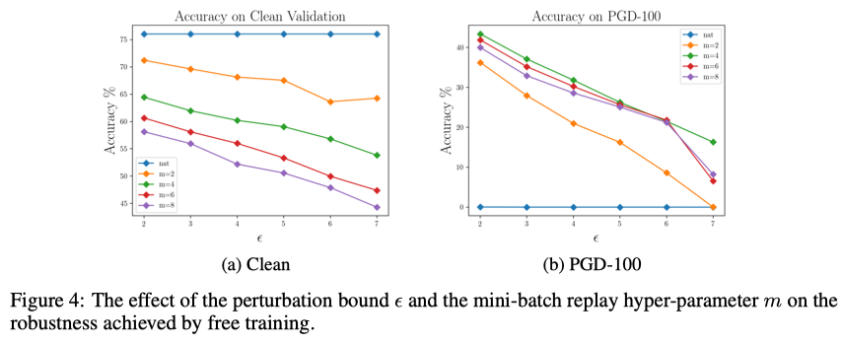
Results on ImageNet(2)

Slide 20
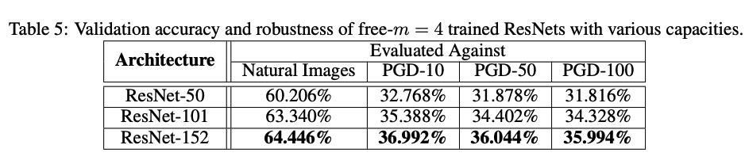
Results on ImageNet(3)
This gap is less than 0.5% if we free train a higher capacity model
worth?

Slide 21
Outline
Preliminaries & Motivation
Approach
Results
Discussion
Conclusions

Slide 22
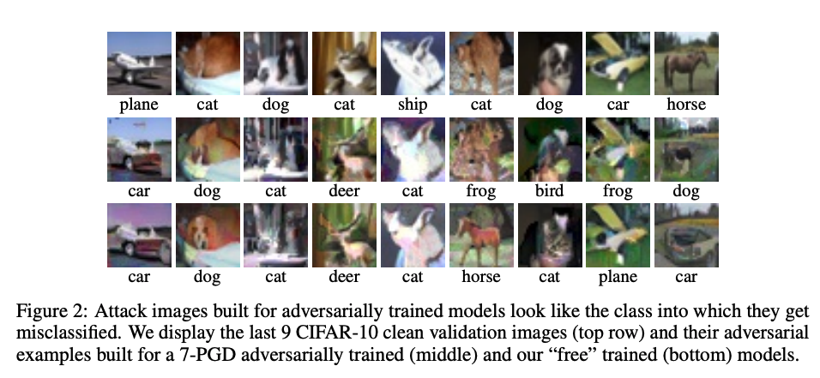
Does “free” training behave like standard adversarial training?（1）
Robustness ✔️
Generative behavior for largely perturbed examples
Tsipras et al. [2018] observed that hardened classifiers have interpretable gradients; adversarial examples built for PGD trained models often look like the class into which they get misclassified.

Slide 23
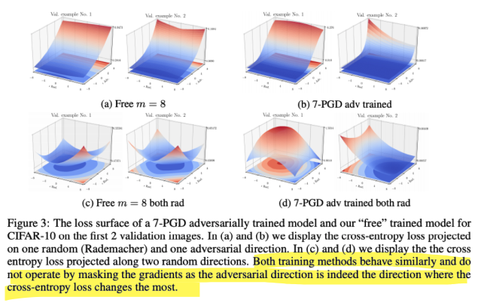
Does “free” training behave like standard adversarial training?（2）
Smooth and flattened loss surface

Slide 24
Outline
Preliminaries & Motivation
Approach
Results
Discussion
Conclusions

Slide 25
Conclusions
Speed up adversarial training
keep the property of adversarial training
robustness ✔️
generative behavior ✔️
smooth loss surface ✔️

